Slide 1
JS Versions
Module 9

Slide 2

History of JavaScript
JavaScript was invented by Brendan Eich in 1995 and has grown to become the world’s most popular programming language.
Although you will rarely hear it called this, the official name of the language is actually ECMAScript (trademark dispute with the name)
ECMAScript’s versions are usually abbreviated to ES1 – 6, although after 2015 it is named by year (ECMAScript 2020)
Notes:
ECMA: European Computer Manufacturer’s Association

Slide 3
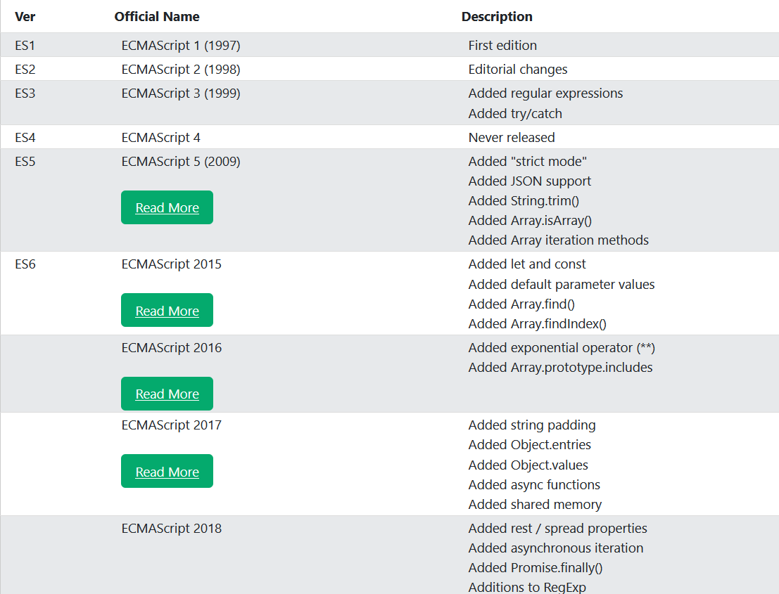

Slide 4
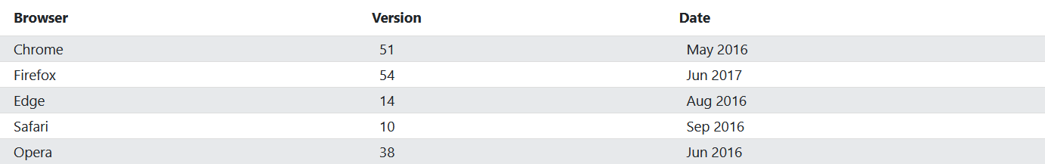
Browser Support for JS

Slide 5
ES5 2009

Slide 6
The ES5 Update
ES5 was the first major revision to JavaScript and was released in 2009
ES5 introduced many of the features we use daily, including strict mode, String.trim(), all of our Array iteration methods, our JSON methods, getter/setter methods, and more

Slide 7

ES5 Syntax Changes
Introduced property access for Strings (string[0])
Allowed trailing commas in Arrays and Object literals (IE8 still doesn’t allow)
Allowed multiline string literals (not using String’s object constructor)
New reserved words

Slide 8
ES6 2015

Slide 9
The ES6 Update
The second major revision to JavaScript
Added many new features, including: let/const, arrow functions, Classes, Promises, Symbols, Default parameter values, the rest operator (…), New Global Methods, New Number Properties/Methods, Modules, and more

Slide 10
ECMAScript 2016

Slide 11
ECMAScript 2016
In 2016, the naming convention changed away from the ES format to ECMAScript + Year
The 2016 update was not major, but introduced some very useful tools
ECMAScript 2016 included: Exponentiation (** operator), Exponentiation Assignment (**= operator), and the .includes() method of Arrays

Slide 12
ECMAScript 2017

Slide 13
ECMAScript 2017
Not a major update
Introduced the following new features: String’s padding methods (padStart/padEnd), the Object.entries() and Object.values() methods, async functions (setTimeout()/setInterval()),

Slide 14
ECMAScript 2018

Slide 15
ECMAScript 2018
Not a major update
Introduced the following new features: asynchronous iteration, Promises’ finally method, Object rest properties, and new RegExp features

Slide 16
Versions History

Slide 17
Versions History
JavaScript was developed for use with Netscape, which lost significant market share to Internet Explorer (wow)
Netscape was the first browser to run JavaScript
Netscape ultimately got incorporated into Mozilla Firefox, but its code is the reason you saw Netscape come up in the BOM Module

Slide 18
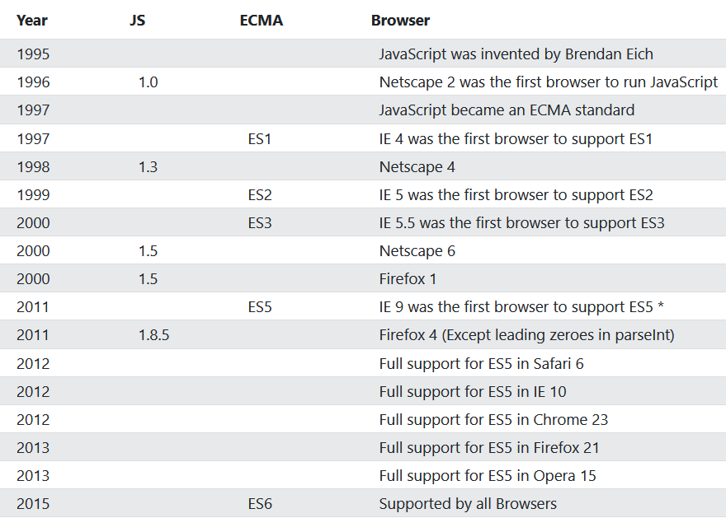
Versions History

